Slide 1
Creating Classes

Slide 2
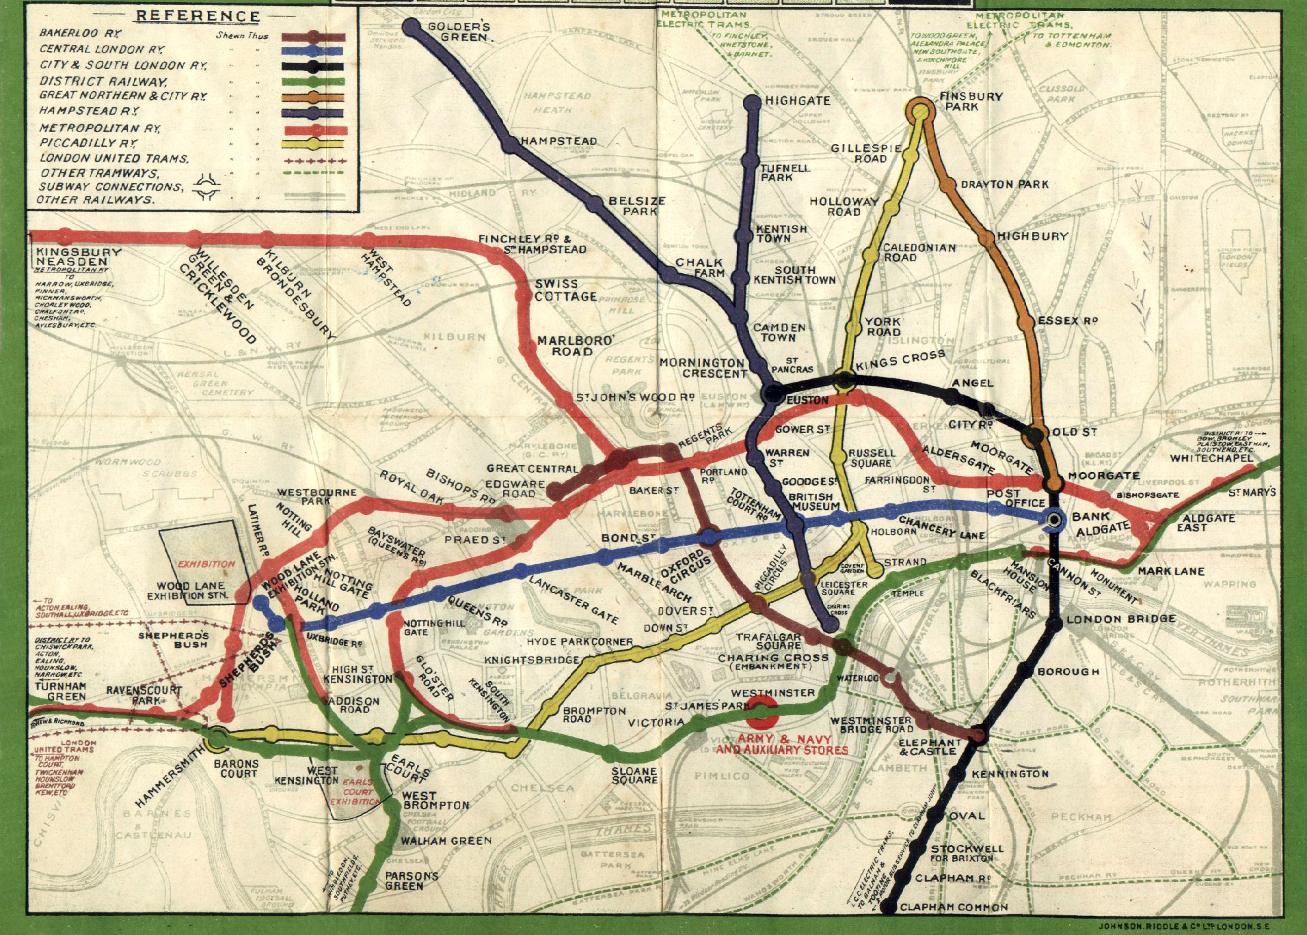

Slide 3
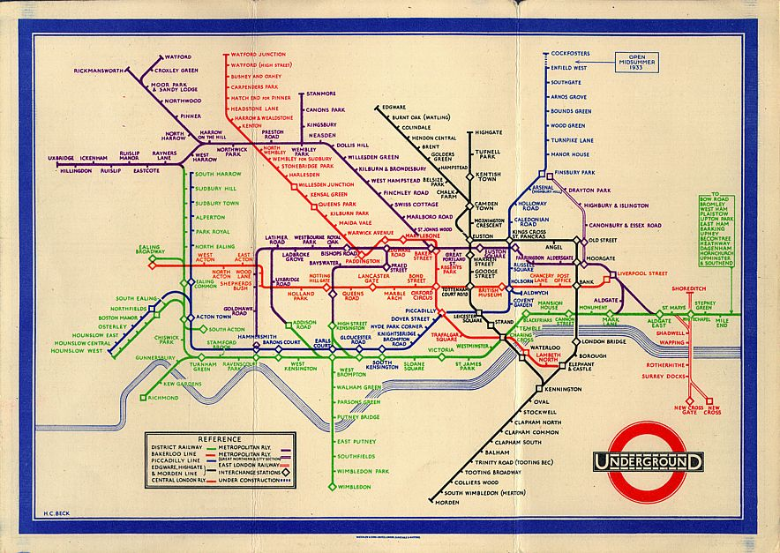

Slide 4


Abstraction
Abstraction is the process of capturing only those ideas about a concept that are relevant to the current situation.
Notes:
These are not faces. This is a circle and two dots, and a curved line. It is an abstraction of a face. And we would use an ABSTRACTION like this in situations where we only care about conveying an emotion, either happy or sad. Other details of actual faces aren't relevant here (like what color their eyes are or do they have any hair). If the only concept is happy/sad, this is all that we need.

Slide 5
Abstraction
Control abstraction: Giving function names to sections of code that then "stand" for that code.
When we call a function, the user of the function (usually) doesn't care how the function works, they just care that it does work.
To a user, the only relevant part is that the function does what it promises to do.
Notes:
example sqrt

Slide 6

Abstraction
Data abstraction: Choosing to represent a concept by certain features and ignoring others.
Notes:
How many of you have been asked by me to describe some code at a different level of abstraction?
(e.g., the game over function in tictactoe: what does it do? It returns true if the game is over. Yes, but that is a very abstract definition.
A more "concrete" (detailed) descritption would be: it returns true when the board is full

Slide 7
Classes
The point of a class is to combine data abstractions with appropriate control abstractions (functions), resulting in one entity that has state (instance variables) and associated behaviors (methods).

